Slide 1

Department of Timeline Security Training Module Information Codes
Mission Critical: STOP and review - this information should be copied exactly.
Informative: SLOW down and read the info. Then, shorten it and write it in your own words.
Bonus: GO on without writing, this is bonus information.

Slide 2
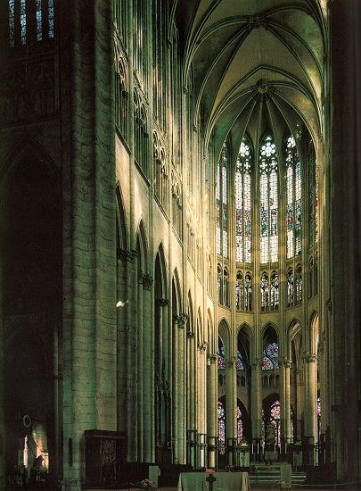
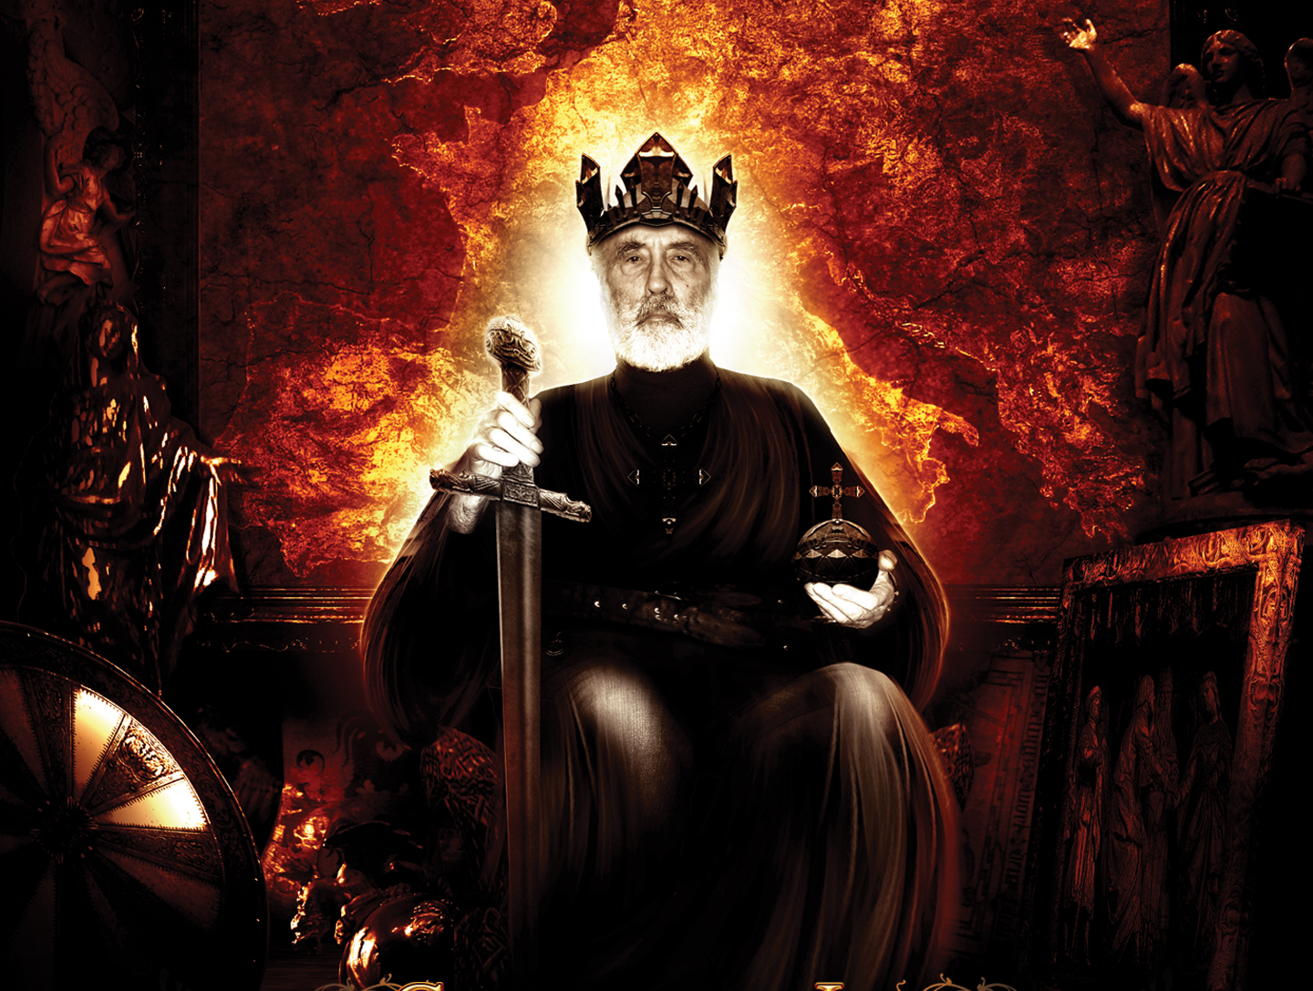
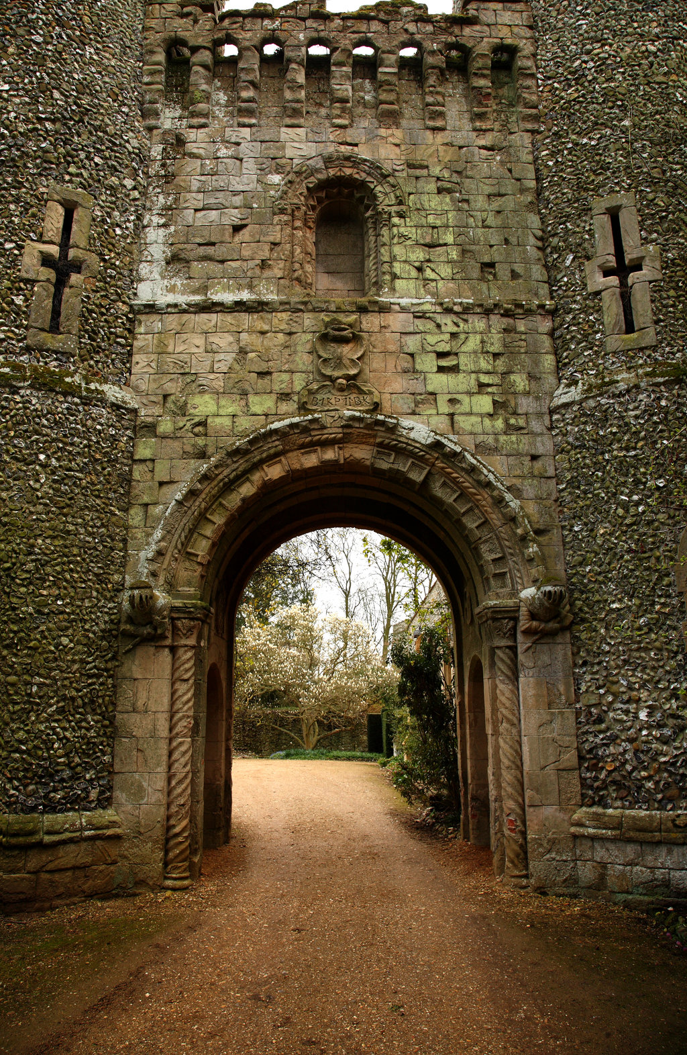
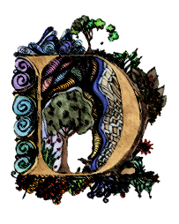
The Dark Ages
Part 1: The Church
ARK AGES
ARK AGES
What makes a hero?
Notes:
1 – Church
2 – Charlie
3 - Feudalism

Slide 3




.
.
.
.
.
.
.
.
.
.
Worlds Collide
.
.
.
.
.
.
.
.
.
.
.

Slide 4
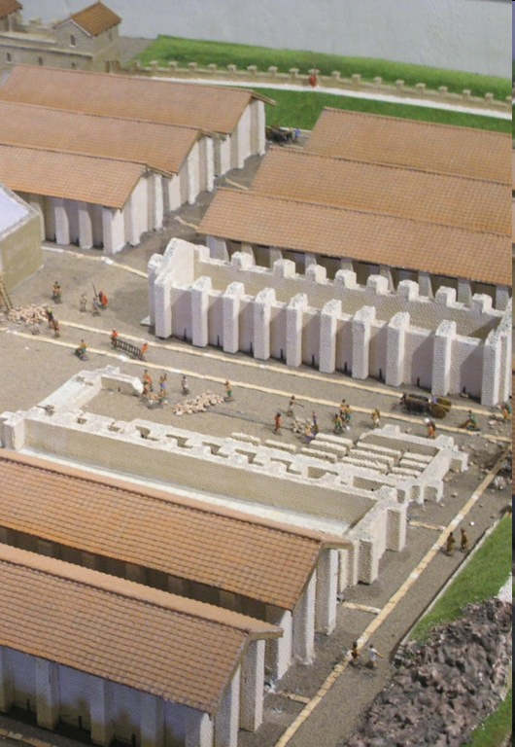
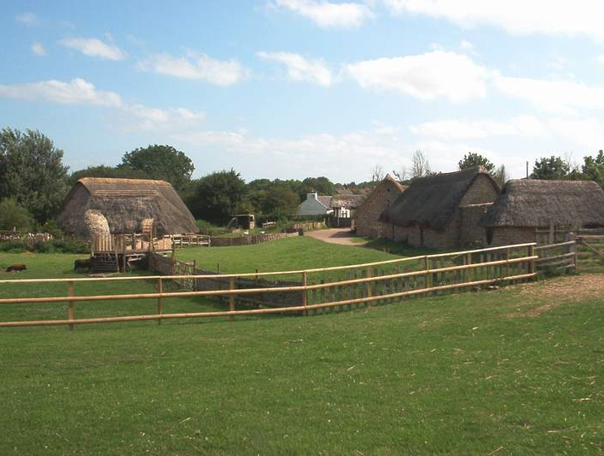
Roman Empire
The Dark Ages
Architecture
ARK AGES
What makes a hero?

Slide 5
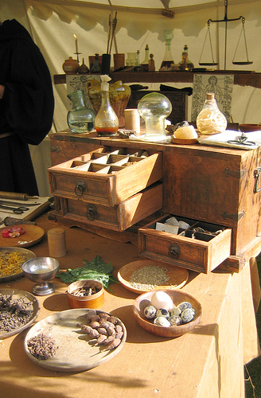
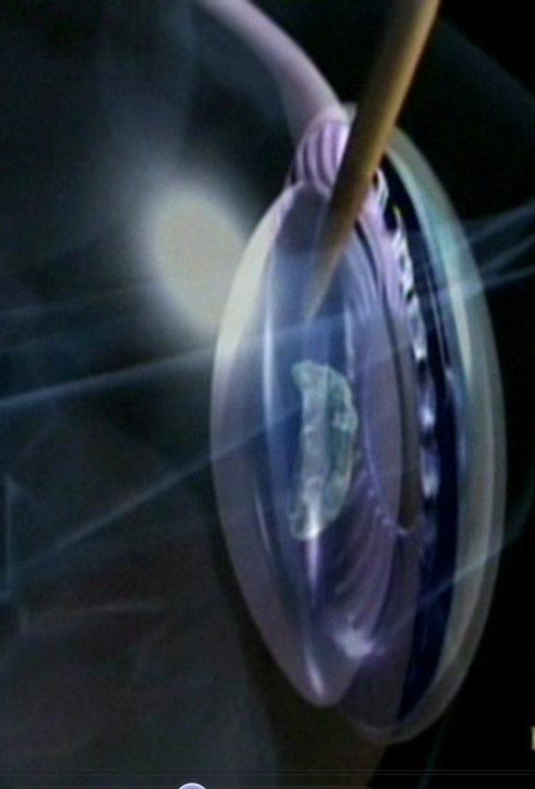
Roman Empire
The Dark Ages
Medicine
ARK AGES
ARK AGES
What makes a hero?

Slide 6
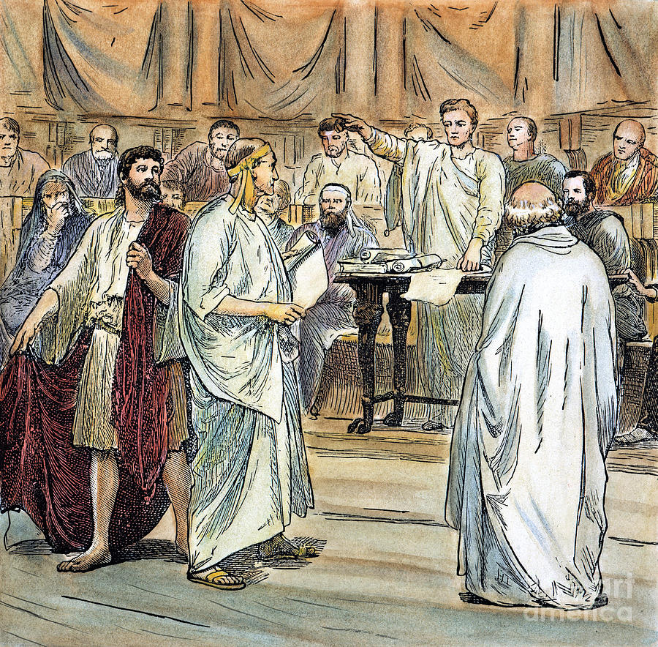
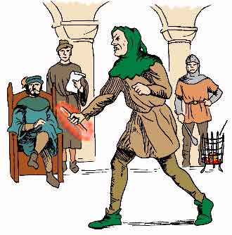
Roman Empire
The Dark Ages
Law
ARK AGES
ARK AGES
What makes a hero?

Slide 7
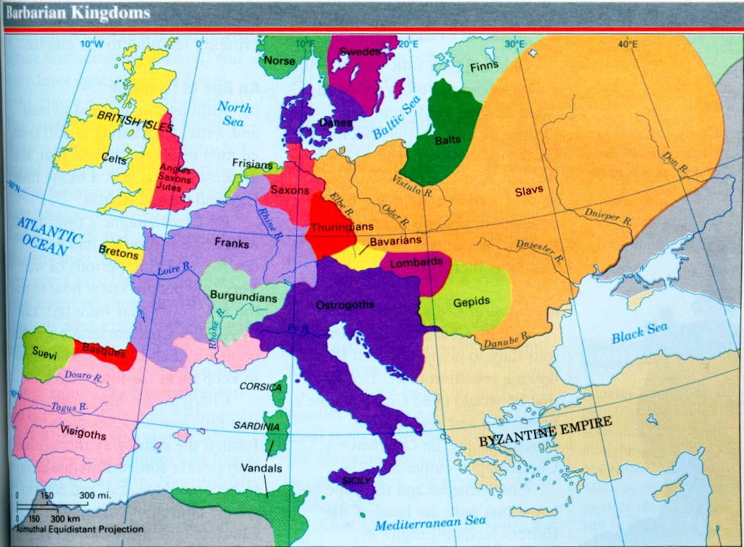
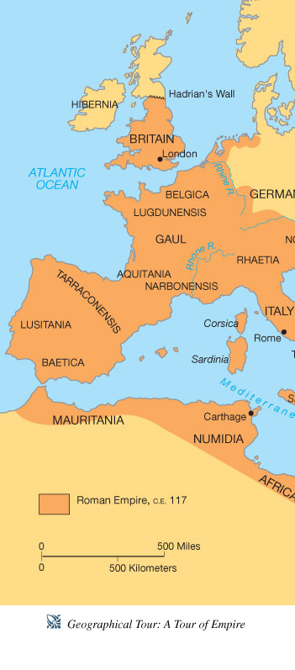
Roman Empire
The Dark Ages
Government
ARK AGES
ARK AGES
What makes a hero?
Notes:
7.6.1

Slide 8
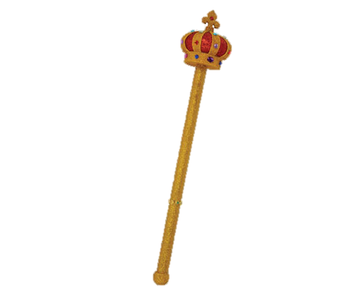
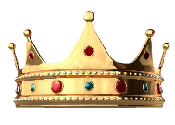
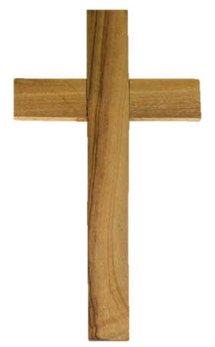
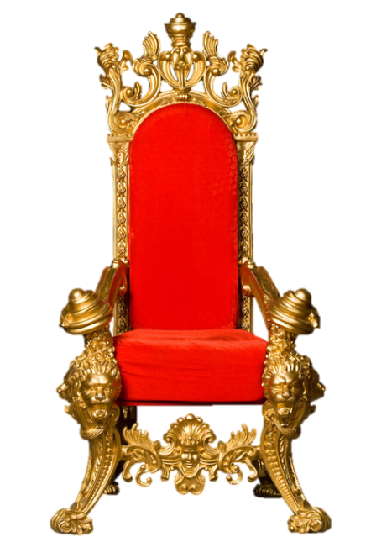
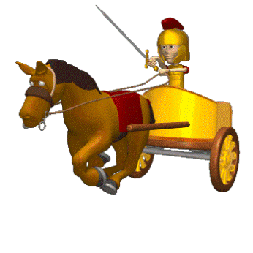

Lost Empire
When Rome fell knowledge, law, culture and technology fell with it.
The army was lost too leaving the people with no protection.
Europe broke up into a bunch of kingdoms.
Most people looked to the Church for leadership.
Notes:
Which of the following statements is true about Europe in the decades shortly after the fall of the Roman Empire? (7.6.1)
Very little changed overall except the geography.
It was broken up into many competing kingdoms.
Almost the entire population left and moved to Asia.
The church lost a great amount of power and importance.

Slide 9
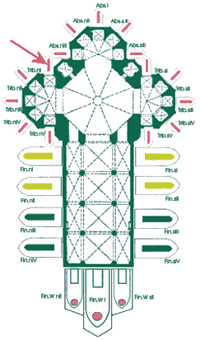
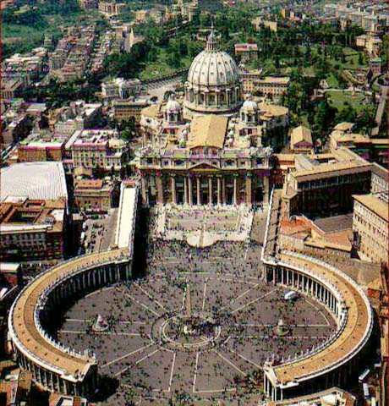
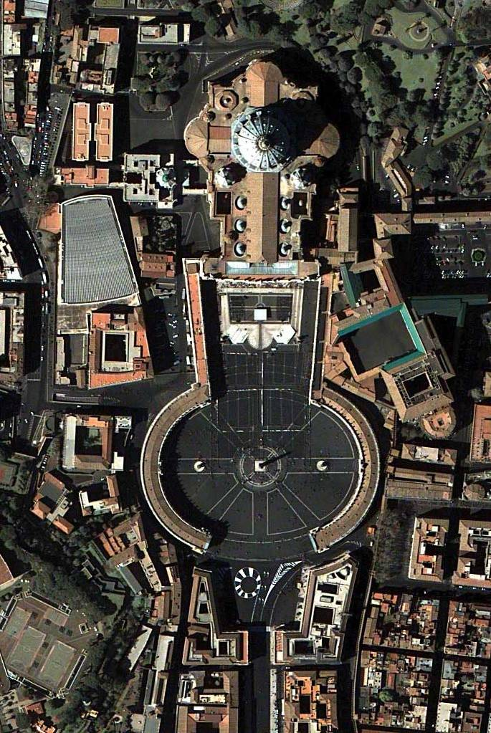
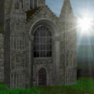
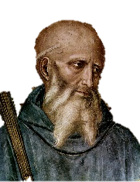
The Church: Featuring
St. Benedict
ARK AGES
What makes a hero?
St. Benedict

Slide 10
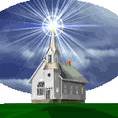
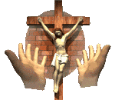
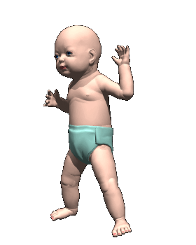
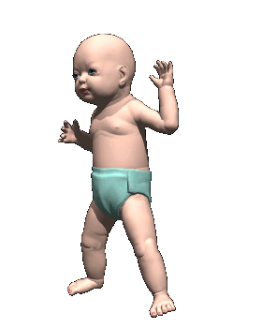

Vocabulary to know:
Excommunication - removing someone’s membership to a church. (kick them out!)
Salvation – taking away sin so people can go to Heaven.
Cathedral - a large church building
St. Benedict
Notes:
Use before storytime?

Slide 11

ARK AGES
What makes a hero?
St. Benedict
Notes:
Storytime

Slide 12


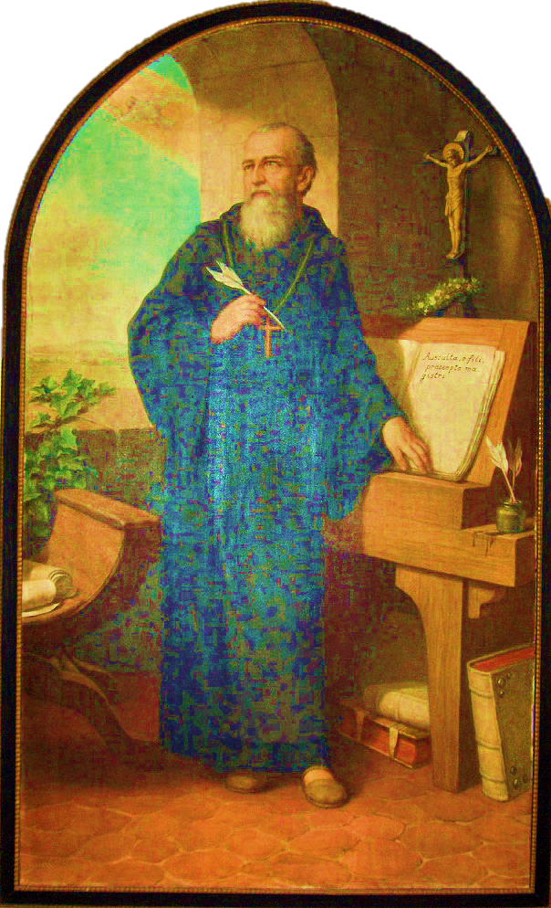
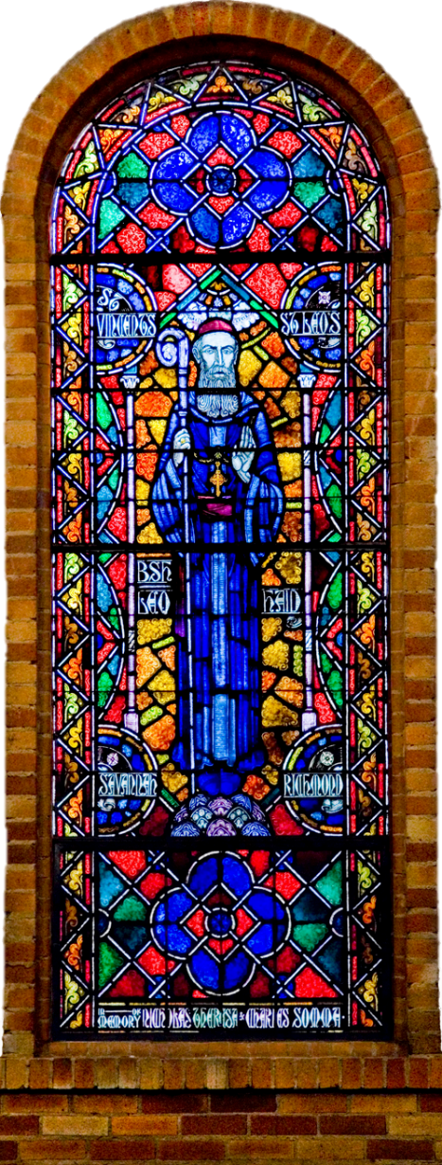
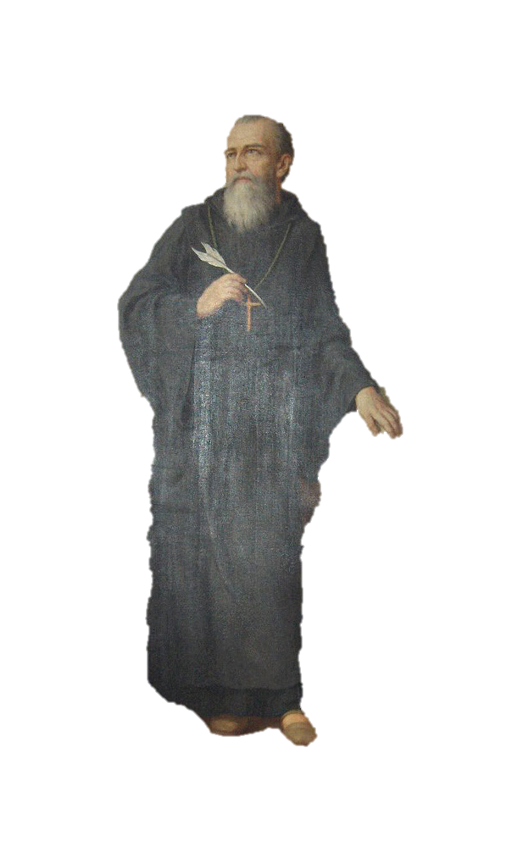
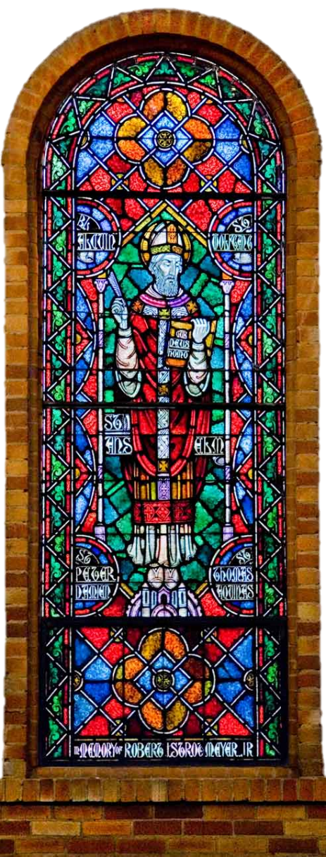
Saint Benedict
ARK AGES
What makes a hero?
St. Benedict

Slide 13
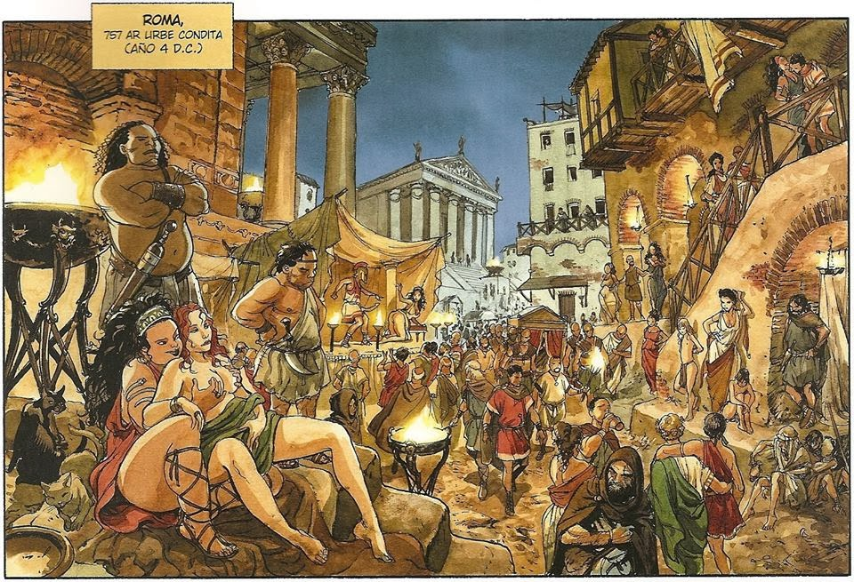
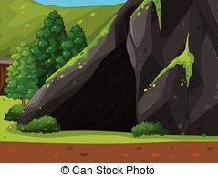
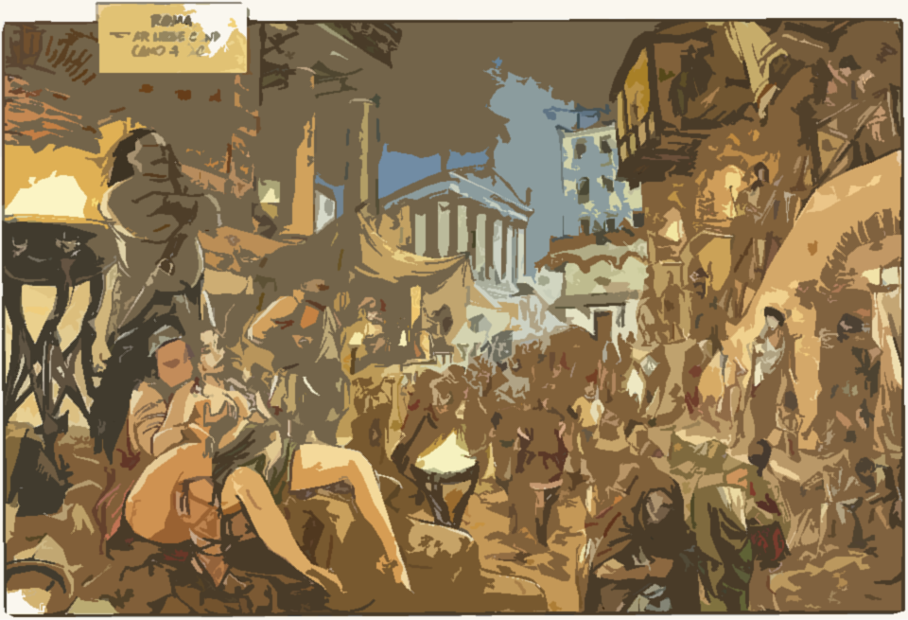
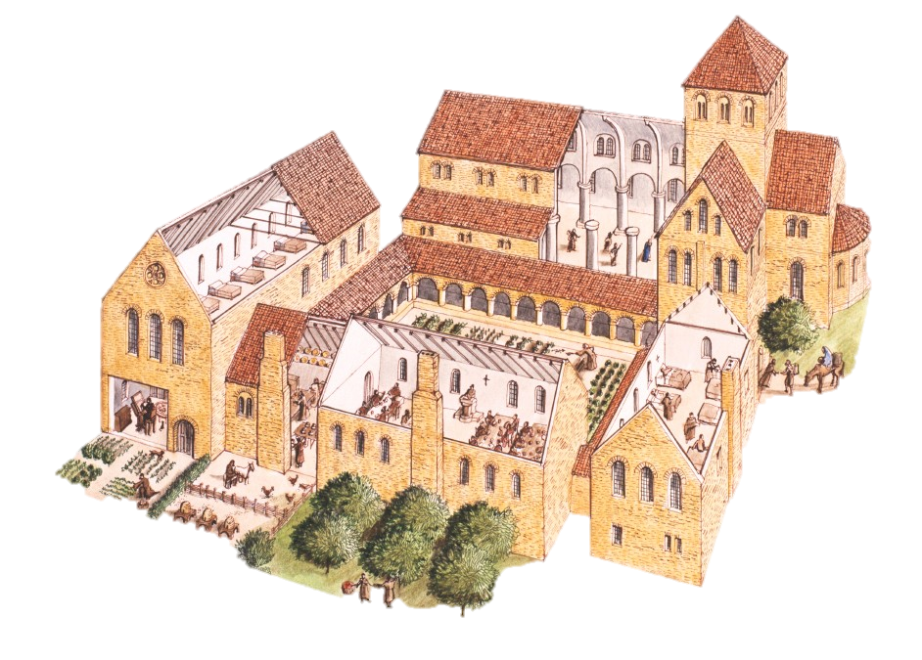




Rome
500 A.D.
Early life: Son of Roman noble after the fall, left Rome due to people’s sin, went to live in cave alone for 3 years. Later life: became so well known for his dedication that he was asked to run the local monastery
ARK AGES
What makes a hero?
St. Benedict

Slide 14
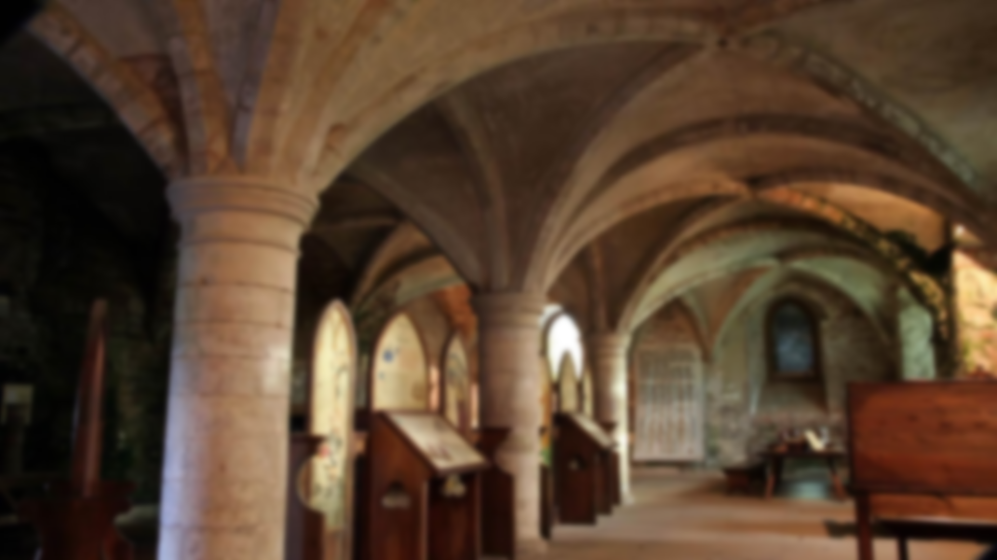
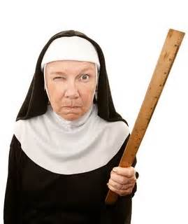
His rules were very strict and he was seen as an outsider. He was not particularly liked by the monks living there.
ARK AGES
What makes a hero?
St. Benedict
Notes:
his rules were very strict and he was seen as an outsider

Slide 15

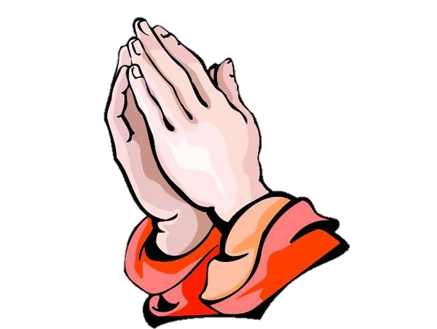
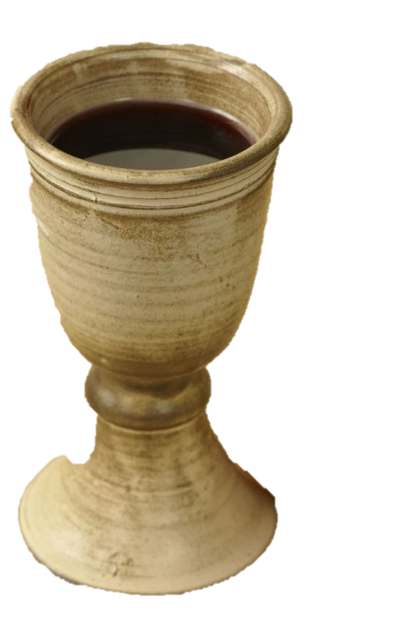
So the monks tried to poison him (his wine), story says as he was praying over it the cup shattered so he couldn’t drink it. Later, another dude tried to poison him out of jealousy,
ARK AGES
What makes a hero?
St. Benedict

Slide 16
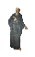
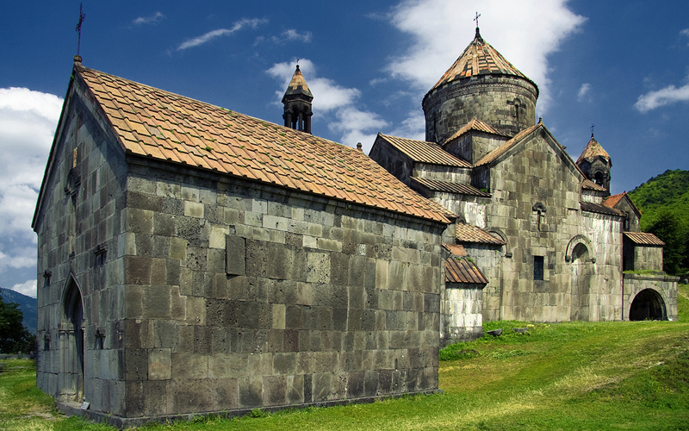
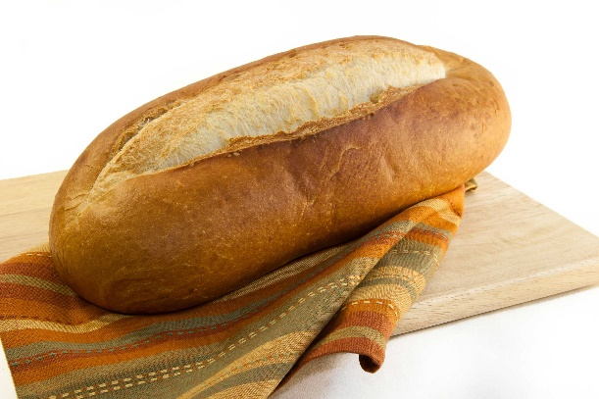
Eventually he left the area and founded his own monastery.
ARK AGES
What makes a hero?
St. Benedict
Notes:
eventually left the area and founded his own monastery.

Slide 17

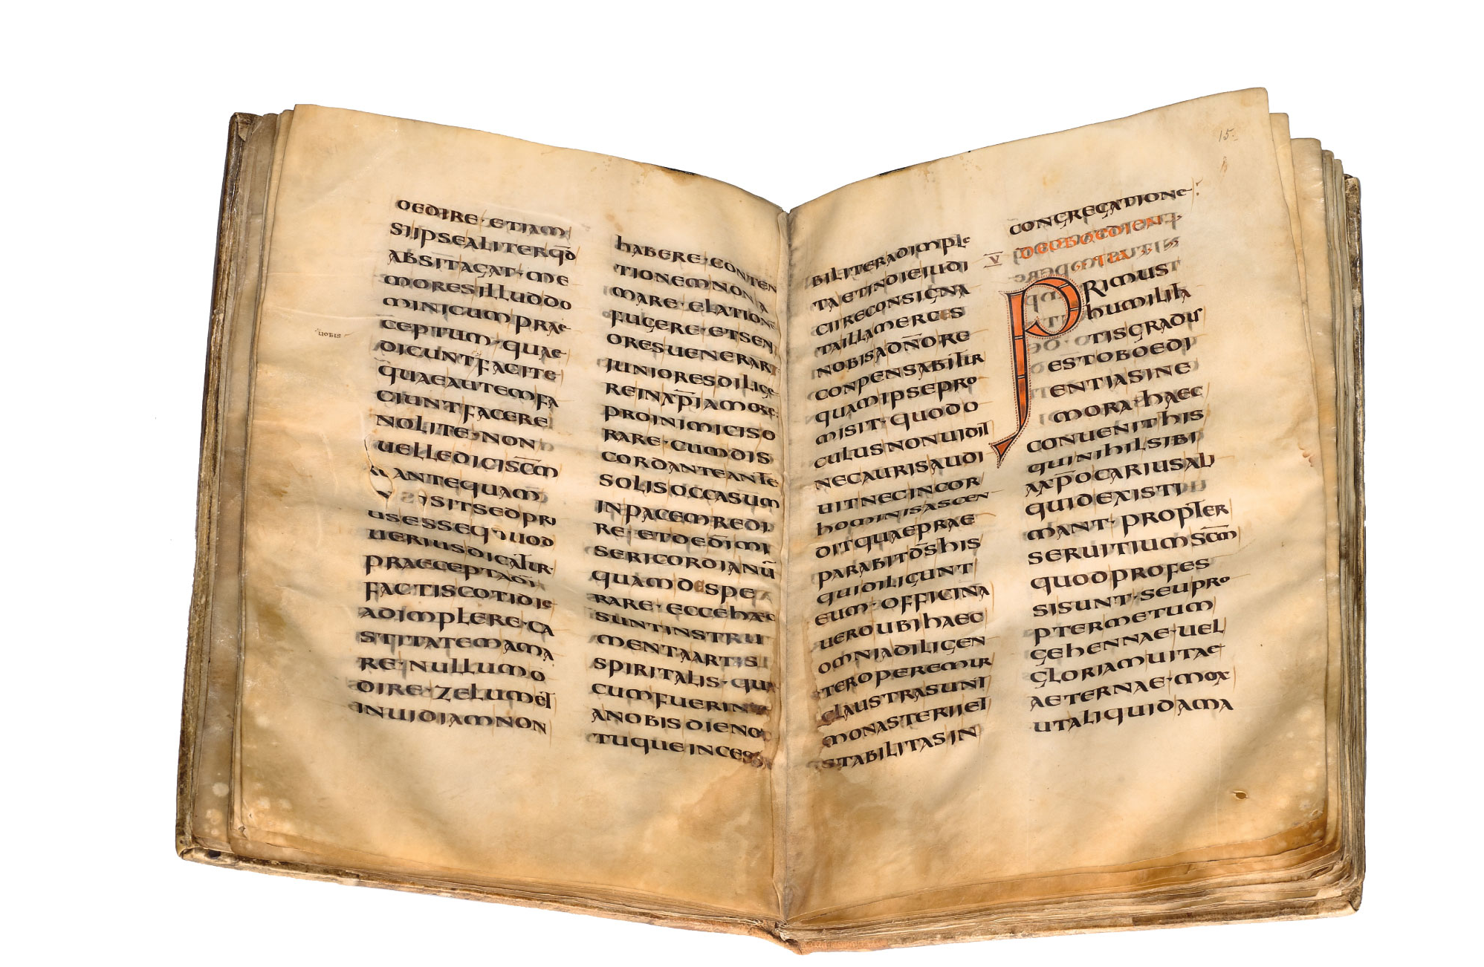
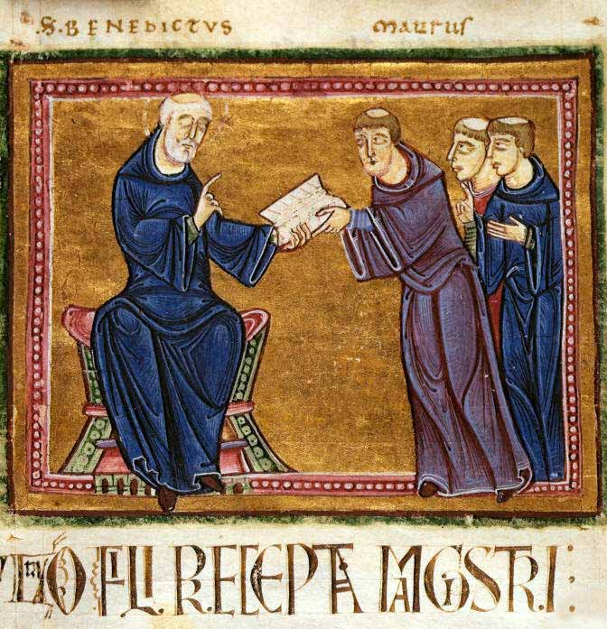
He decided to put his rules in writing.
Notes:
Put his rules in writing

Slide 18
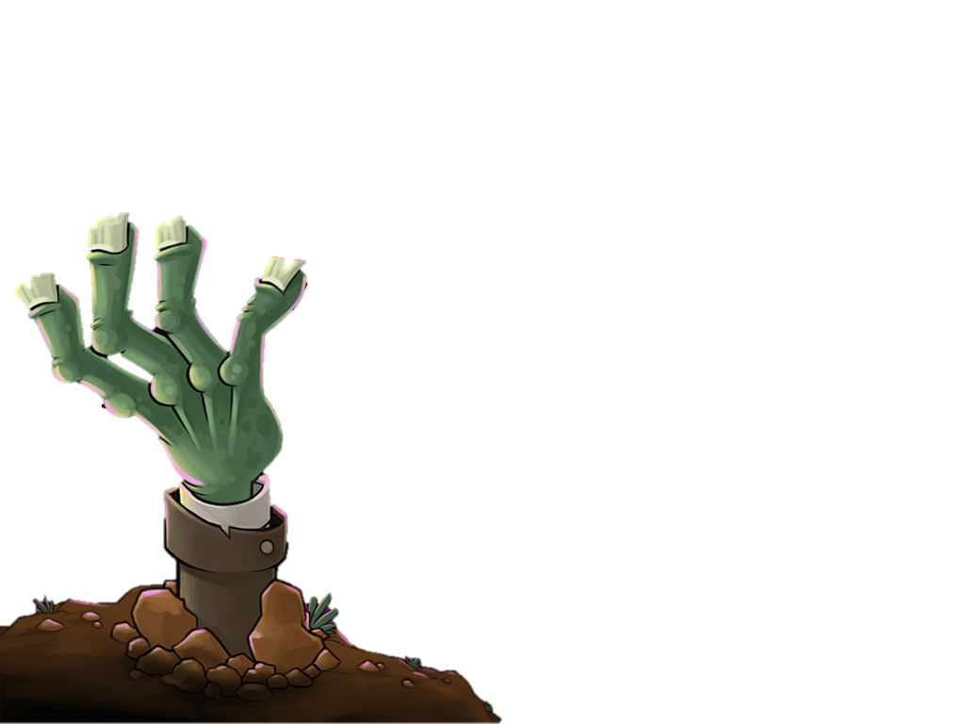
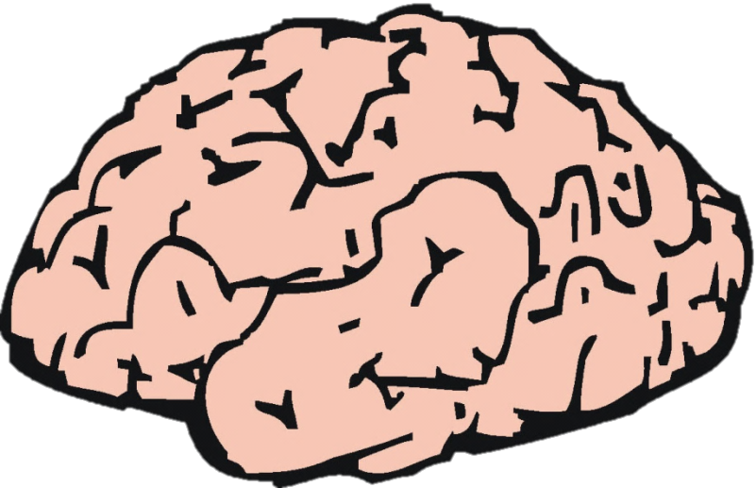
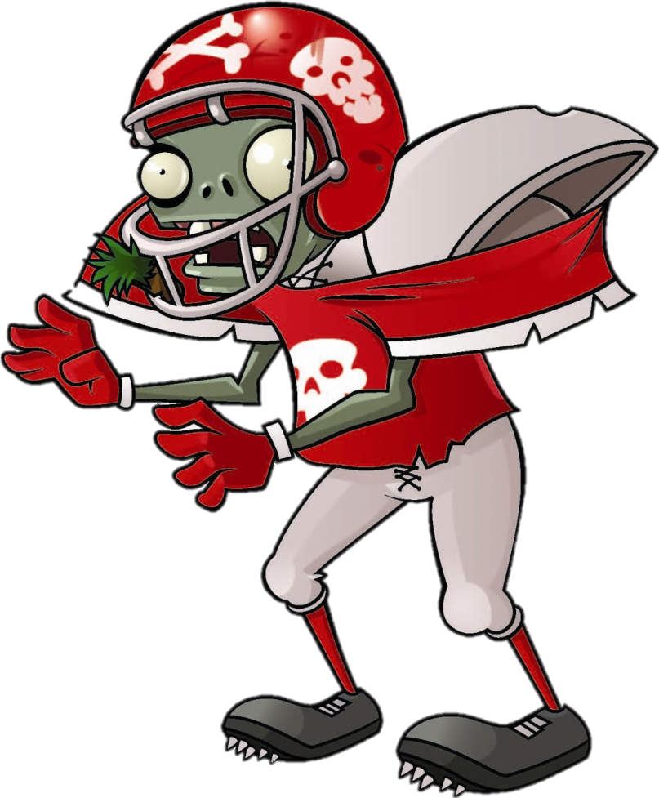
Brain
Snack
.
.
.
.

Slide 19
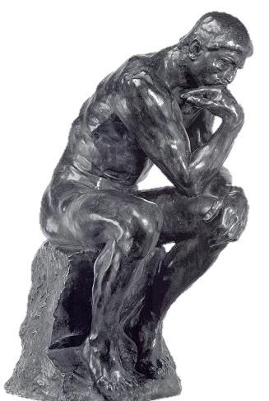
Ponder
What rules do you think he wrote?
Write one rule you think St. Benedict wrote for his monastery.

Slide 20
We must care for the old, sick and very young.
All monks in the monastery are seen as equals.
We will pray daily, many times.
We must not talk too much.
We will create schools for the Lord’s service to teach the way to salvation.
We will eat two times a day and will not eat the meat of any four-footed animals.

Slide 21
The Christian Church brought some stability to the people.
They provided education and help for the poor.
The monks copied many books by hand.
Eventually huge cathedrals were built to show the glory of God.
ARK AGES
What makes a hero?
St. Benedict
Notes:
Use as storytime follow up slide
What provided one of the only stable connections to earlier times after the collapse of the Western Roman Empire? (7.6.2)
King
Christian Church
Tax system
Germans

Slide 22
Brain
Snack
.
.
.
.

Slide 23


Draw It!
Notes:
Picture/artist

Slide 24
Draw a cathedral
Notes:
Picture/artist

